Slide 1

THE LEGAL CIRCLE
TO ENSURE NATURAL JUSTICE

Slide 2

WELCOME TO MY PRESENTATION
FATAMA TUZ ZUHURA
BATCH-21
DEPARTMENT OF LAW
1ST OCTOBER 2024

Slide 3
INTRODUCTION:
Law is the system of rules and regulations that govern society, providing a framework for resolving disputes and maintaining order. Laws are the bedrock of individual rights. They grant people the freedom to express themselves, practice their beliefs, and enjoy basic liberties without fear of infringement. Legal protections against discrimination, unlawful detention, and privacy violations ensure that each person’s rights are safeguarded, contributing to a just and inclusive society.
The Legal Circle is a modern, innovative and solution -centered full- service law firm, serving clients from home and abroad.

Slide 4

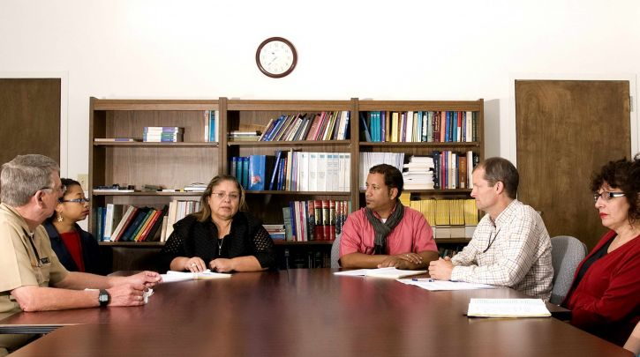
Dispute Resolation:

Slide 5
Civil
Criminal
Commertial
Family
Arbitration
SERVICE:

Slide 6
MISSION:
To ensure natural Justice of our clients.
ADDRESS:
3rd Floor of House-21, Road-7, Sector-3, Dhaka – 1200, Bangladesh.

Slide 7

SESSION TIME:

Slide 8


